Slide 1
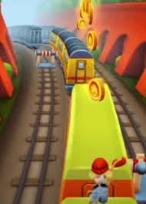
Introduction and Prototype
An endless runner showcasing a character (the runner) who runs the whole way up in front of obstructions. The player needs to swipe the screen in order for runner jumps or slide through different obstacles.

Slide 2
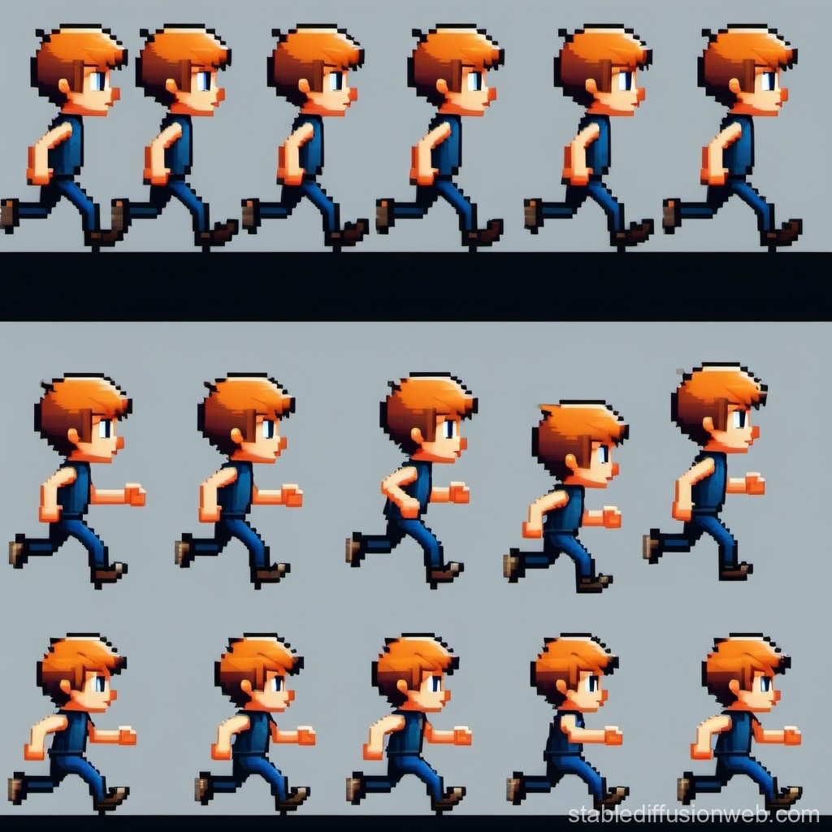
Sprites
(Characters)
Geometrical
Shapes
Boundary and collision checks
Squares and Rectangles
Usage: Blocks: Brick blocks, ground tiles.
Circles
Usage: Coins: Collectibles.
Lines
Usage: Boundaries: Edges of platforms or zones.
Ensuring the players does not pass through the obstacles.

Slide 3
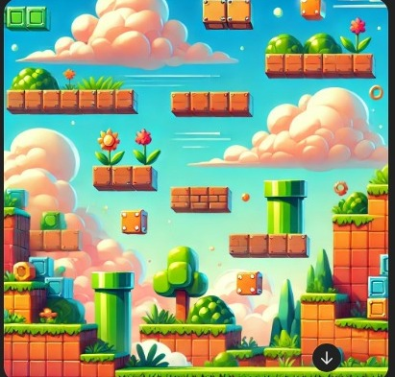
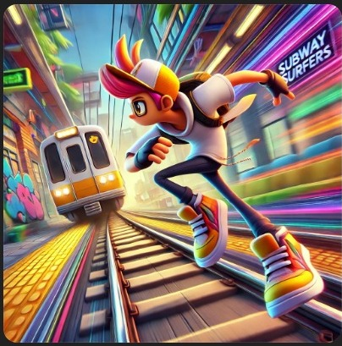
Frame Animation
Physics Animation
Scoring
Gravity: When character jumps, he doesn’t float or move linearly. Gravity pulls him down, creating a smooth curve as he falls
Collision Detection: Character interacts with the environment by colliding with platforms, enemies, or obstacles.
Jump Mechanics:The longer the button is pressed, the higher character jumps, thanks to impulse forces.
Scoring on the basis of jumps
Mouse /Keyboard Interaction
On pressing the button character will jump

